Slide 1
Clinical Agentic AI
Multi-Agent Pipeline for Clinical Data Derivation
Clinical CSV + Derivation Spec → Analysis-Ready Table + Audit Trail
Anand Murugan

Slide 2
Agenda
01
The Problem
Memory & Reusability
06
Four pressures driving the need for systematic clinical data derivation
Short-term state + long-term pattern memory
Traceability
02
Why not monolithic LLM call for this ?
07
Every inference and intervention is auditable
Three failure modes of a naive approach
LLM Resilience
03
Core Design Principle
08
Anthropic → GPT-4o failover + circuit breaker
Constraining LLM autonomy for reliability
Design Decisions
Architecture
09
04
Six trade-offs explained
Agent topology, memory, and flow
HITL Gates
10
Production-Ready Nest Steps
05
Improvements for production
Spec review · Code approval · Refiner escalation

Slide 3
The Problem
Clinical derivation is
manual, error-prone,
and impossible to
audit at scale.
We need a system that
is fast, correct,
trustworthy, and
human-supervised.
Automation
Derivation specs run into hundreds of variables. Manual scripting is unsustainable at clinical trial scale.
Correctness
Regulatory submissions require zero-tolerance for derivation errors across every variable in every dataset.
Auditability
Every transformation must be traceable back to the source rule with a verifiable, regulator-readable evidence chain.
Human Oversight
Regulators and scientists need structured checkpoints to review, correct, and approve at critical pipeline junctures.

Slide 4
Why not monolithic LLM call for this?
01
02
03
Hallucination Without Detection
No Audit Trail
No Human Checkpoint
An LLM generates plausible-looking code or derivation logic that is subtly wrong. Without a static validator, test runner, and verifier in the loop, the error propagates silently into the output dataset — undetected until downstream review.
A single LLM call produces a result but leaves no evidence of how each column was derived. Regulatory submissions require a traceable chain from source data to final variable — a raw LLM response provides absolutely none of this.
Derivation specs are inherently ambiguous. Without a structured gate to surface ambiguities to a domain expert, the LLM makes a silent guess — and may be wrong. There is no structured recovery path when the guess is incorrect.
A production clinical tool needs more than a smart model — it needs structure, verification, and human authority.

Slide 5
Core Design Principle
5 Key Principles:
Safety First : Multiple validation gates (input guardrails, spec review, code validation, execution verify) prevent unsafe derivations.
Transparency & Auditability : Every step logged with full audit trail. Decision lineage traceable for regulatory review.
Human-in-the-Loop : Critical decisions don't happen in black box—humans always have override/clarification chance via HITL gates.
Resilience & Recovery : 12-phase orchestrated pipeline with checkpointing. Any validation failure triggers feedback loop—resume from checkpoint instead of restart.
Deterministic Orchestration (Custom, Not LangGraph) :
Why custom? Regulated domains demand:
Single-threaded by default (not parallel) → reproducible, auditable runs
Checkpointing as core (not plugin) → cheap resume from failure
HITL gates as structural (not bolted-on) → gates at Preapproval & Verify phases, not arbitrary conditions
Event-driven lineage → every decision has full state snapshot for FDA/EMA audit trails
Why not LangGraph? Optimizes for speed & flexibility, not compliance. No first-class checkpointing, defaults to parallelism, treats HITL as conditional logic instead of architecture.

Slide 6
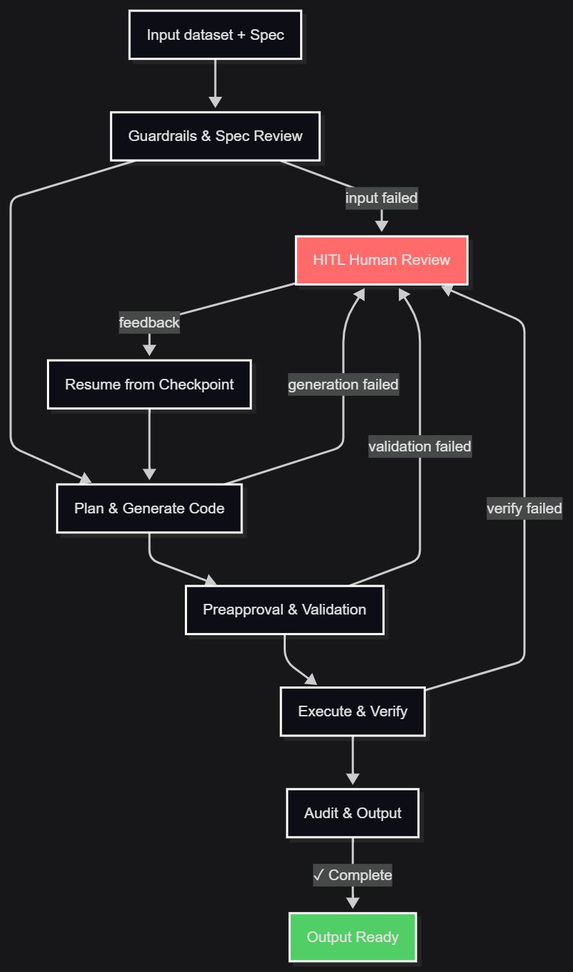
Architecture Block Diagram

Slide 7
Human-in-the-Loop — Three Gates
G1
Spec Review
G2
Code Approval
G3
Refiner Escalation
Agent
Agent
Agent
02 Spec Reviewer
06 Code Preapproval
11 Refiner
Triggers
Triggers
Triggers
Before DAG is built
After code generation, before full execution
When automated retries are exhausted
Shows
Shows
Shows
If the Refiner cannot resolve a verification failure after N attempts, it escalates with a structured explanation.
Ambiguities, missing fields, and contradictions in the derivation specification are surfaced as a structured question form.
Generated derivation code presented for human review alongside the spec. Test-case results shown.
Outcome
Outcome
Outcome
Expert approves code or requests changes. Prevents running untrusted code at full dataset scale.
Expert diagnoses root cause: spec error, edge-case data, or logic flaw — and guides resolution.
Expert confirms, corrects, or rejects the spec. Pipeline proceeds only on approval.

Slide 8
Memory & Reusability
Short-Term Memory
Long-Term Memory
Captures the current run’s recent context:
input validation results
current plan/code generation state
last HITL decisions and clarifications
Used to keep the active run coherent:
prevents repeated questions to the agent
maintains recent reasoning and guardrail context
Lifetime: only while the run is active / session-scoped
Stores reusable knowledge across runs:
past run patterns
safety and validation outcomes
recurrent user preferences or common fixes
Used to improve future runs:
speeds recovery from similar errors
supports more consistent guardrail behavior
enables auditability of repeated issues
Lifetime: persists across runs and sessions
Together Short-term memory gives the pipeline immediate context and continuity within a run and Long-term memory gives the pipeline institutional knowledge and learning across runs
.

Slide 9
Traceability —Audit Tables
Traceability means every inference and intervention is auditable from input to output
Full run provenance
every run stores input, spec, decisions, outputs, and final result
Phase-level event logging
guardrails, planning, code gen, validation, execution, and audit are all recorded
Checkpointed state snapshots
recoverable state at defined pipeline phases ensures exact replay
HITL decision capture
human approvals, rejections, and clarifications are stored with the run
Failure feedback loops
every error path is traceable back to the phase that triggered HITL or retry
Regulatory-ready output
line items for “who did what, when, and why” across the workflow

Slide 10
LLM Resilience — Failover + Circuit Breaker
PRIMARY
SECONDARY
LAST RESORT
Anthropic Claude
primary fails
OpenAI GPT-4o
both fail
Deterministic rule Fallbacks
Failover Logic
Primary / fallback chain
try Anthropic first
if Anthropic fails on 5xx / overload / network / timeout, automatically retry the same prompt on OpenAI
Retry budget
each provider gets up to 3 attempts
exponential backoff: 2s → 4s → 8s
worst-case wait per provider is about 14 seconds
Circuit breaker
opens after 2 consecutive provider failures
stays open for 60 seconds
while open, the pipeline fails fast to deterministic/HITL fallback instead of burning another long LLM call
Why this matters?
preserves availability by failing over quickly
avoids repeated long retries during an outage
keeps regulated runs moving by shifting to deterministic or human-reviewed paths in seconds instead of minutes

Slide 11
Demo
Clinical CSV + Derivation Spec → Analysis-Ready Table + Audit Trail

Slide 12
Key Design Decisions
Deterministic Orchestrator over LangGraph / CrewAI
"LLM or human, never silent guess"
It is a strict, readable state model where every pipeline transition is explicit
No hidden loops, no implicit agent behavior, no black-box state
Auditors can inspect one clear file and see every legal transition
Compliance needs a deterministic workflow, not an open-ended graph
It makes the pipeline easier to trace, reproduce, and validate
Every ambiguity is resolved by the LLM with a stated rationale, or escalated to a human gate. The system never silently picks a default.
Per-question HITL forms
Test-case gate before full execution
Each gate question is a discrete, structured record — queryable, prefillable from LTM, and stored in the audit trail independently.
Generated code proven on 3 synthetic rows before running on N rows. Bugs caught at the gate cost seconds; bugs at full scale cost hours.

Slide 13
Production-Ready Next Steps
Scale-grade audit storage
Multi-tenancy + SSO
Replace SQLite/file-based storage with a cloud-ready transactional database and audit store
SSO handles login/authentication
multi-tenancy : separate users/teams need isolated audit trails, data boundaries, and access controls
production requires both secure sign-in and proper tenant isolation
Distributed resilience
Safer execution policy
Move circuit breaker state to shared storage (Redis or service mesh) so outages survive process restarts
Current AST whitelist is intentionally conservative
Production should support richer safe derivation patterns with validated policy updates
Stronger LLM recovery
Responsive review UX
OpenAI/Anthropic structured output can still fail on malformed JSON
Improve output contracts, retries, and deterministic fallback behavior
Gate 2 currently loads full generated code
Add pagination/lazy loading for large derivations
These are not flaws — they are the next production hardening steps: scale, isolation, resilience, and enterprise-ready auditability

